Slide 1
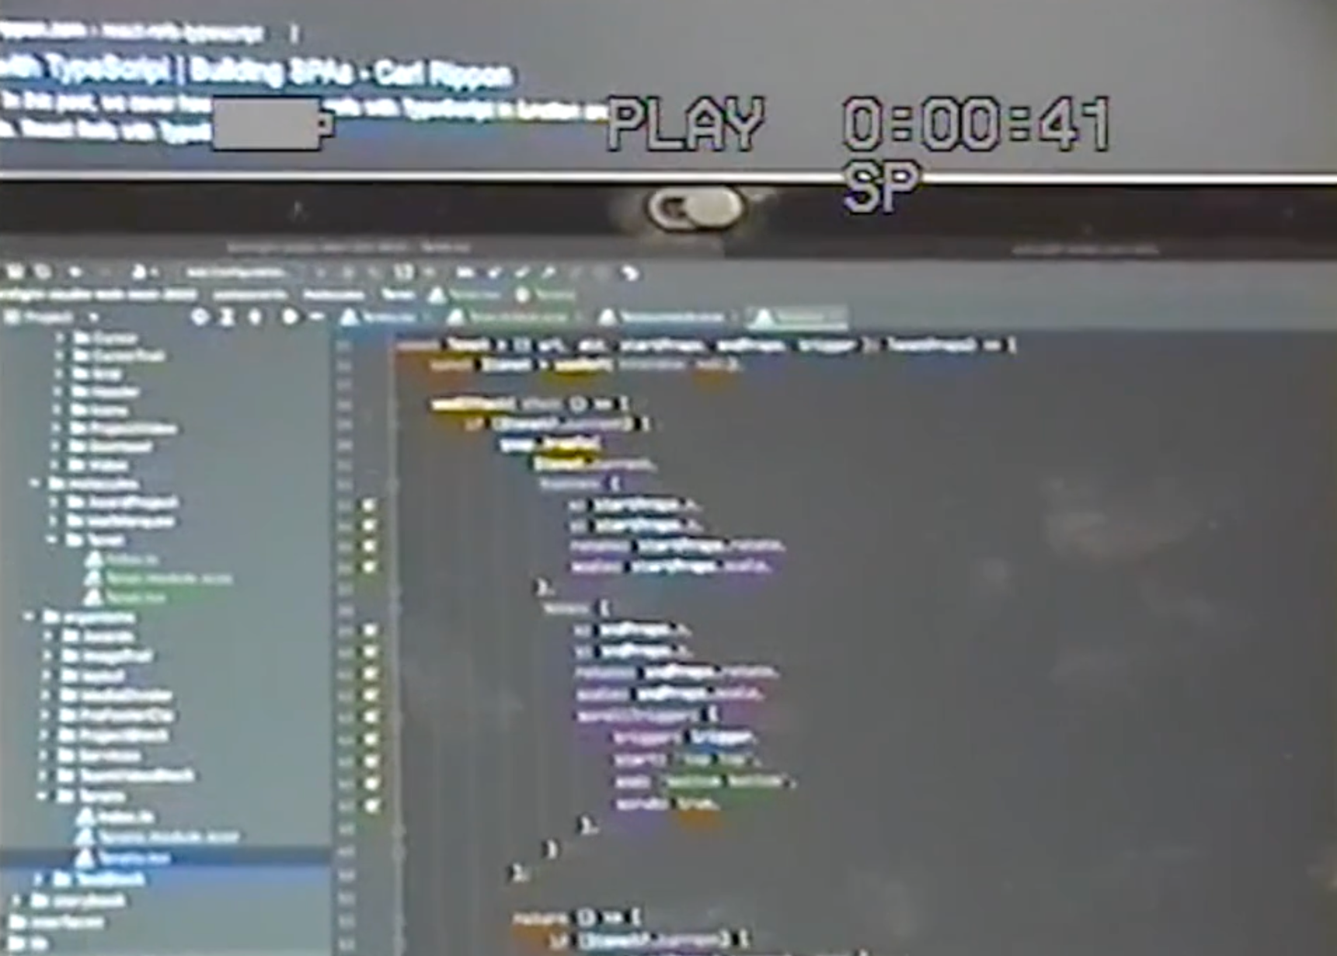
BORNFIGHT STUDIO®
i kreativne web stranice
14.12.2022.
BORNFIGHT STUDIO®

Slide 2
14.12.2022.
MARIO LONČAREK Creative front-end developer at BORNFIGHT STUDIO®
Linkedin — www.linkedin.com/in/mario-loncarek Github — https://github.com/marioloncarek Dev.to — https://dev.to/marioloncarek Codepen — https://codepen.io/riogrande
BORNFIGHT STUDIO®

Slide 3
https://bornfight.com
Notes:
Guide slide
Design system

Slide 4
https://bornfight.studio/

Slide 5
14.12.2022.
Projekti
Ljubicic Tennis Academy
Rimac Automobili
PET PAK
Gideon
BORNFIGHT STUDIO®
Taur
https://www.ljubicicacademy.com/
https://www.rimac-automobili.com/
https://petpak.si/
https://www.gideon.ai/
https://www.bornfight.studio/
https://taur.com/
BORNFIGHT STUDIO®

Slide 6
14.12.2022.
Što stranicu čini kreativnom?
Ideja / koncept
Dizajn
Detalji
Interakcija
Animacije
Tranzicije
Mikro-interakcije
3D
BORNFIGHT STUDIO®

Slide 7
14.12.2022.
Gdje se inspirirati
1/2 — WEB STRANICE
AWWWARDS — https://www.awwwards.com/
THE FWA — https://thefwa.com/
CSS DESIGN AWARDS — https://www.cssdesignawards.com/
SITEINSPIRE — https://www.siteinspire.com/
TYMPANUS — https://tympanus.net/codrops/
HOVERSTAT.ES — https://www.hoverstat.es/
Analiza - “raskopavanje”
BORNFIGHT STUDIO®

Slide 8
14.12.2022.
Gdje se inspirirati
2/2 — CREATIVE DEVELOPERS
BRUNO SIMON — https://twitter.com/bruno_simon
ARISTOIDE BENOIST — https://twitter.com/AristideBenoist
LUIS HENRIQUE — https://twitter.com/bizar_ro
LORENZO DOSSI — https://twitter.com/lorenzodossi
BORNFIGHT STUDIO®

Slide 9
Alati
14.12.2022.
CSS GSAP / GSAP Scroll Trigger three.js barba.js smooth scrolling
BORNFIGHT STUDIO®

Slide 10
14.12.2022.
CSS
Tranzicije / mikro-interakcije
https://codepen.io/riogrande/pen/xOXbPK
https://codepen.io/riogrande/pen/JjGYRWZ
BORNFIGHT STUDIO®

Slide 11
14.12.2022.
GSAP
Animacije
https://greensock.com/gsap/
https://codepen.io/GreenSock
https://codepen.io/GreenSock/pen/wvwEOZL
https://codepen.io/GreenSock/pen/GRrQKP
https://greensock.com/docs/v3/Eases
BORNFIGHT STUDIO®

Slide 12
14.12.2022.
GSAP ScrollTrigger
Animacije na scroll
https://greensock.com/scrolltrigger/
https://greensock.com/st-demos/
https://codepen.io/GreenSock/pen/WNvVOWw
https://codepen.io/GreenSock/pen/JjYPQpN
BORNFIGHT STUDIO®

Slide 13
14.12.2022.
three.js
3D / WebGL
https://threejs.org/
https://threejs.org/examples/
BORNFIGHT STUDIO®

Slide 14
14.12.2022.
barba.js
Tranzicije između stranica
https://barba.js.org/
BORNFIGHT STUDIO®

Slide 15
14.12.2022.
Smooth scrolling
Locomotive & Lenis
https://locomotivemtl.github.io/locomotive-scroll/
https://github.com/studio-freight/lenis
BORNFIGHT STUDIO®

Slide 16
hello@bornfight.studio

